Slide 1
Image Captioning System
By Anagha Sarmalkar & Shweta Patil

Slide 2
Introduction
Goal - Generating captions for images by identifying features in an image and generating semantically correct sentence as it description.
Motivation - Learn and understand the challenges in Natural Language Generation
Applications - Self driving cars, Aid to the blind, Google Image Search

Slide 3
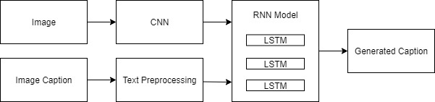
Model Architecture

Slide 4
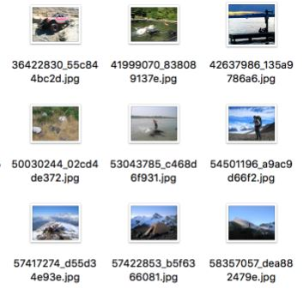
Data
Flickr 8K dataset - 8000 images divided into 6000 training, 1000 validation images and 1000 testing images.
Annotated images with each image paired with five descriptions.

Slide 5
Preprocessing
Image preprocessing Image loading & resizing Image feature extraction using VGG model Storing training image features for later use by training model | Text Preprocessing Sentence preprocessing - Removing punctuations, lower-casing & adding start-end tokens Vocabulary generation Term tokenization Storing term-tokenization output for later use by training model

Slide 6
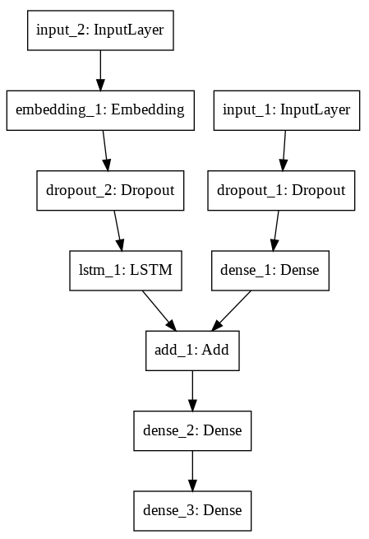
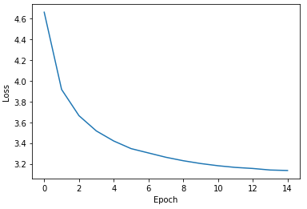
Image Captioning Model

Slide 7
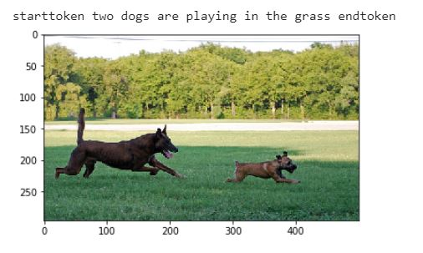
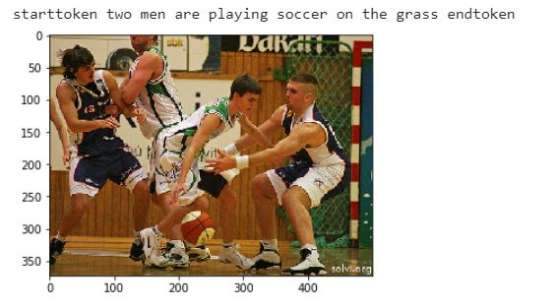
Sample Output

Slide 8
Evaluation
BLEU Score: Bilingual Evaluation Understudy is an algorithm used for comparing machine generated text data with human specified actual data
BLEU-1: 0.329550
BLEU-2: 0.136576
BLEU-3: 0.075454
BLEU-4: 0.025752

Slide 9
Future Scope
Experimenting with other pretrained image models for better object detecting within images
Using word vectors on much larger corpus available on web
Experimenting with model layers and fine-tuning the parameters for achieving better BLEU score

Slide 10
Thank You!

